Slide 1
NON-VERBAL
COMMUNICATION
“The most important thing in communication is to hear what is not being said”
-Peter Drucker

Slide 2
Types of Non-verbal Communication
Kinesics
Proxemics
Chronemics
Occulesics
Paralanguage or Para Linguistics
Artifacts
Haptics

Slide 3
Kinesics
the study of posture, movement, gestures and facial expressions

Slide 4
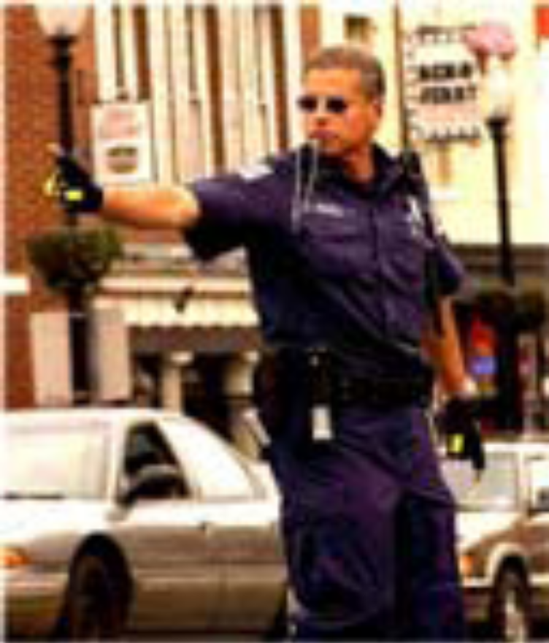
Functions
• Replacing spoken
messages.
Reinforcing
verbal messages

Slide 5
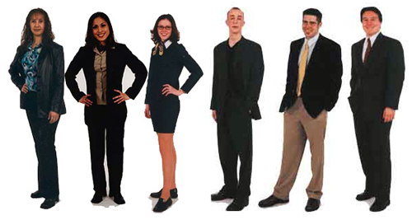
POSTURE

Slide 6
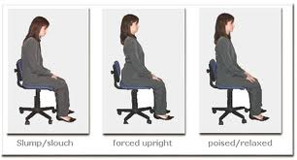

Slide 7


Some common postures:
arms folded across the chest : unsympathetic
arms held loose : open positive attitude
upright posture : high status , I am the boss
bowing head : lower status
sideway lean : relaxation, friendliness
self wrapping : withdrawal, self protection
slouching with forward lean : lowliness
moderately upright : enthusiasm, friendliness

Slide 8
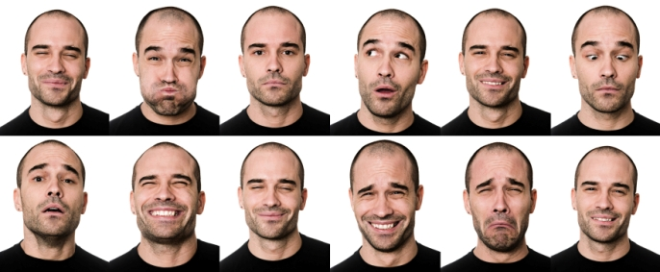
FACIAL EXPRESSIONS
Facial expressions reflect emotion, feelings and attitudes

Slide 9
The Face
The face is an important source of information.
Since the face cannot be easily hidden, it is an important source of nonverbal information and communicates a variety of emotions.
In addition, eye contact, pupil size, and the smile provide additional cues to informed observers.

Slide 10
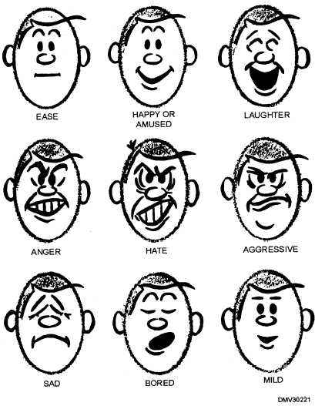
Facial expressions

Slide 11
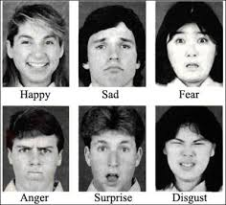
Six basic emotions

Slide 12
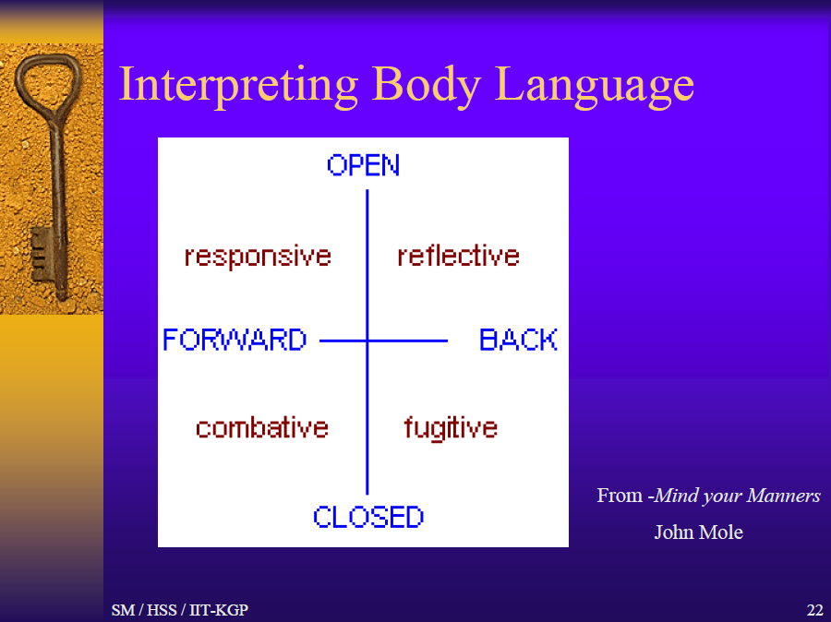

Slide 13
Knowing how to read body language is a useful communication skill. So is knowing how to use it.There are two basic groups of body language postures: OPEN/CLOSED and FORWARD/BACK
OPEN/CLOSED is the most obvious. People with arms folded and legs crossed and bodies turned away are signalling that they are rejecting messages. People showing open hands, fully facing you and both feet planted on the ground are accepting them.
FORWARD/BACK indicates whether people are actively or passively reacting to communication. When they are leaning forward and pointing towards you they are actively accepting or rejecting the message. When they are leaning back, looking up at the ceiling, doodling on a pad, cleaning their glasses they are either passively absorbing or ignoring it.
The posture groups combine to create four basic modes: responsive, reflective, combative and fugitive.

Slide 14
In responsive mode, OPEN/FORWARD the person is actively accepting. This is the time to close the sale, ask for agreement, demand a concession
In reflective mode, OPEN/BACK, people are interested and receptive but not actively accepting. Trying to close the sale or asking for agreement now may drive them away into fugitive mode. This is the time to present further facts and incentives. It may also be a good time to keep quiet and let them think.
In fugitive mode, CLOSED/BACK, people are trying to escape physically through the door or mentally into boredom. This is the time to spark interest in any way you can, even irrelevant to the message.
Finally, in combative mode, CLOSED/FORWARD, there is active resistance. This is the time to defuse anger, avoid contradiction and outright argument and to steer them into reflective mode.
How these modes are expressed in posture and gestures varies from culture to culture.

Slide 15
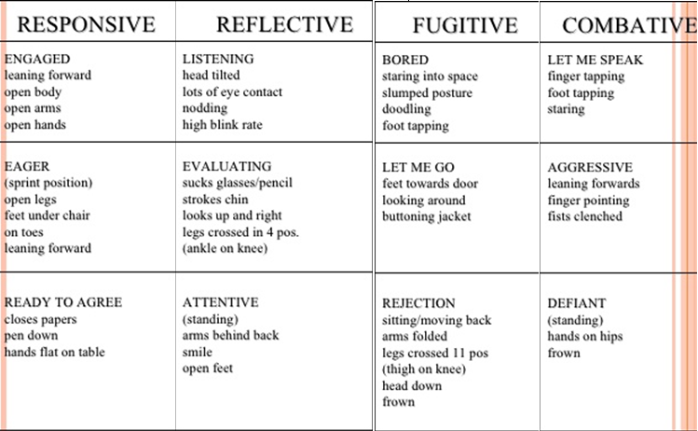
Gesture clusters for each of the positions i.e. responsive, reflective, combative and fugitive are as below:

Slide 16
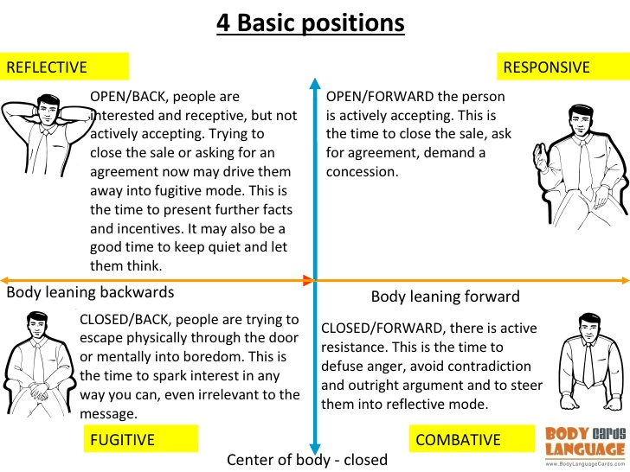

Slide 17
Responsive
EAGER (sprint position)
♦Open Legs
♦Feet under Chair
♦On Toes
♦Leaning Forward
READY TO AGREE
closes papers
Pen Down
Hands Flat on Table
ENGAGED leaning forward
Open Body
Open Arms
Open Hands

Slide 18
Reflective
LISTENING with head tilted
Lots of Eye Contact
Nodding
High Blink Rate
EVALUATING : sucking glasses / pencil
Stroking Chin
Looking Up and Right
Legs crossed in 4 pos.
Ankle on Knee
ATTENTIVE (standing)
Arms behind Back
Smile
Open Feet

Slide 19
Combative
LET ME SPEAK
finger tapping
Foot Tapping
Staring
leaning forwards
Finger Pointing
Fists Clenched

Slide 20
Fugitive
BORED
Slumped Posture
Doodling
Foot Tapping
Staring into space
LET ME GO
Looking Around
Buttoning Jacket
REJECTION sitting/moving back
Arms Folded
Legs Crossed
Thigh on Knee
Head Down
Frown

Slide 21
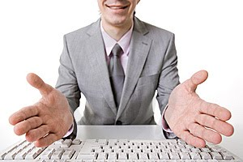
Common Gesture Clusters
Openness:
Several gestures indicate openness and sincerety.
Open hands,
unbuttoned coat or collar,
leaning slightly forward in the chair,
removing coat or jacket,
uncrossing arms and legs,
moving closer.

Slide 22
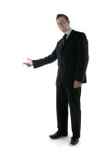
When people are proud of what they have done, they usually show their hands quite openly.
When they are not often put their hands into their pockets, or hide back
When people show signals of openness that means they are generally beginning very comfortable in your presence which is good.

Slide 23
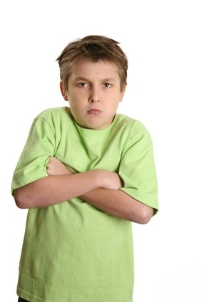
Common Gesture Clusters
Defensiveness:
People who are defensive usually have
a rigid body,
arms or legs tightly crossed,
eyes glancing sideways or darting occasionaly,
minimal eye contact,
lips pursed, fists clenched and downcast head.

Slide 24
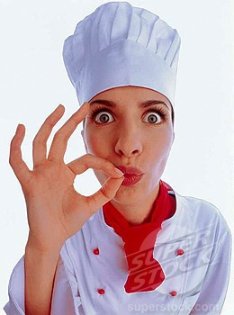
Common Gesture Clusters
Evaluation:
Evaluation gestures say that the other person is being thoughtful or is considering what you are saying. Sometimes in a friendly way sometimes in an unfriendly way.
Typical evaluation gestures include:
    tilted head,
    hand to cheek,
    leaning forward and
    chin stroking.

Slide 25
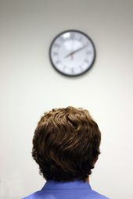
Common Gesture Clusters
Boredom or Impatience
These unproductive feelings are usually conveyed by the
Drumming of fingers
Cupping the head in the palm of the hand,
Foot swinging
Brushing or picking a lint
Looking at your watch or the exit.

Slide 26
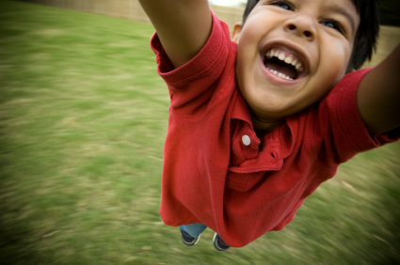
Common Gesture Clusters
Enthusiasm
This is an emotion that you love to see in other people and they in you.
It is conveyed by
    A small upper or inward smile,
    Hands open and arms extended outward,
    Eyes wide an alert,
    A lively and bouncy walk,
    A lively and well-modulated voice.

Slide 27
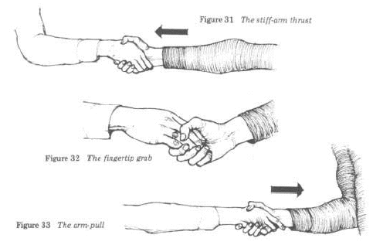
Handshakes

Slide 28
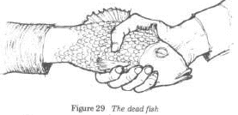
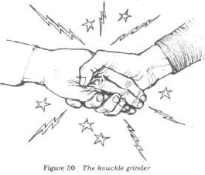
The knuckle Grinder
Dead fish

Slide 29
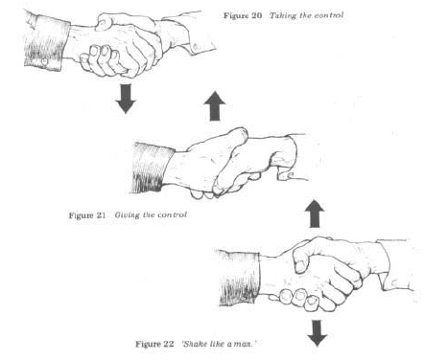

Slide 30
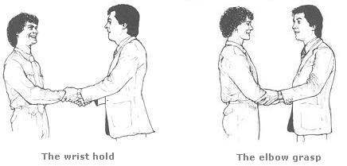
Double Handed Hand Shake
The intention of the double-handed handshake is to show sincerity, trust or depth of feeling towards the receiver. Left hand is used to communicate the extra feeling that the initiator wishes to transmit and its extent is related to the distance that the initiator’s left hand is moved up the receiver’s right arm.
Elbow Grasp - The elbow grasp, transmits more feeling than the wrist hold, and the shoulder hold.
-the wrist hold and the elbow grasp are acceptable only between close friends or relatives.

Slide 31
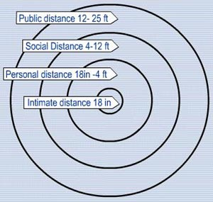
Proxemics-Space Language
(study of distance individuals maintain between each other while interacting and its significance)

Slide 32
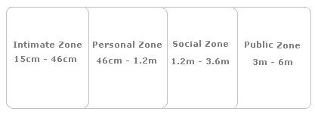
Zone Distances
Intimate Zone
Only those who are emotionally close to that person are permitted to enter it.
This includes parents, spouse, children, close friends and relatives
Personal Zone
we stand from others at cocktail parties, office parties, social functions and friendly gatherings.
Social Zone
We stand at this distance from strangers, the plumber or carpenter doing repairs around our home, the postman, the local shopkeeper, the new employee at work and people whom we do not know very well.
Public Zone
Whenever we address a large group of people, this is the comfortable distance at which we choose to stand.

Slide 33
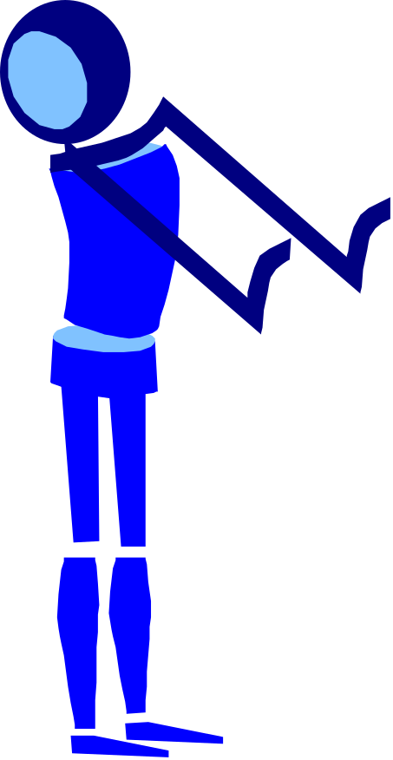
WHEN YOU INVADE MY SPACE
Reactions to an invasion of your space
Feel troubled
Get defensive
Become aggressive
Retaliate

Slide 34
OCCULESICS
“Eyes are so transparent
that through them
one sees the soul”
“Look a person in the
Eye when you
Talk to him”

Slide 35




GAZE BEHAVIOUR
FORMAL GAZE
INFORMAL GAZE
PERSONAL GAZE
LATERAL GAZE

Slide 36
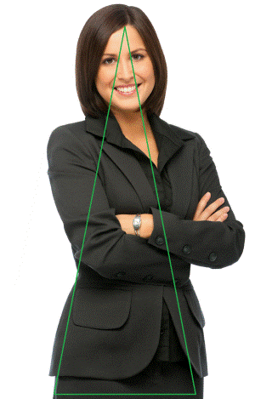
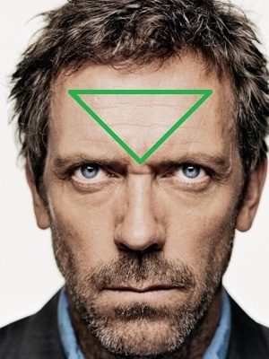
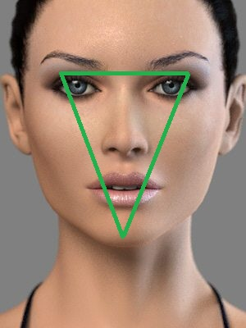

Slide 37
PURPOSE FOR EYE CONTACT
SPEAKING INFORMATION
SHOWING ATTENTION AND INTEREST
INVITING AND CONTROLLING INTERACTION
DOMINEERING, THREATENING, INFLUENCING
OTHERS
PROVIDING FEEDBACK DURING SPEECH

Slide 38
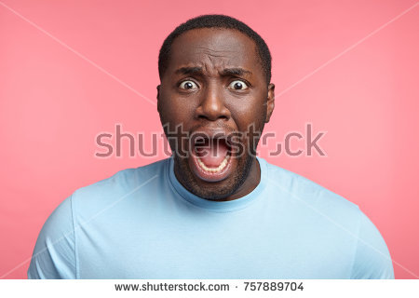
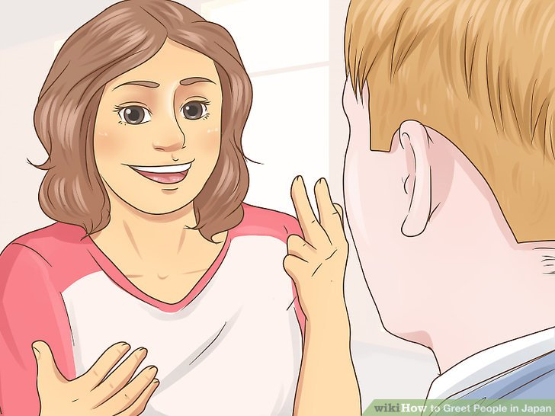

Slide 39
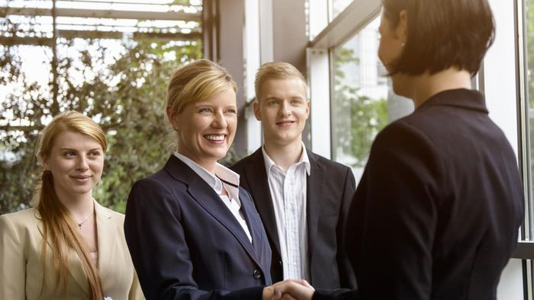

Slide 40
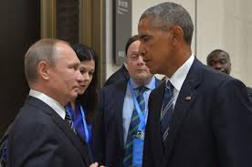

Slide 41
Too much eye contact: dominance, lack of respect, threat, wish to insult
Too little eye contact: not paying attention, impolite, insincere,shy
Withdrawing eyes: signal of submission

Slide 42
Paralinguistics
Paralinguistic features – non-word characteristics of spoken language..
It includes characteristics like speaking speed, volume, pitch, pauses, rhythm, quality and voice modulation. As a good speaker, you need to focus on your paralanguage to effectively connect with your audience.

Slide 43
Voice
Pitch variation
monotones fail to keep listener’s attention
People in authority or When excited speak in high pitched voice
Speaking Speed
Fluency in language is not the same thing as the speed of speaking
present easy parts of message at a brisk pace and difficult, complicated parts at slower pace.
In state of anxiety, urgency we speak fast and when relaxed at a comfortable speed.

Slide 44
Volume Variation
Loudness of our voice should be adjusted according to size of audience
Some speakers believe only way to sound convincing is to speak louder
Proper word stress

Slide 45
Non fluencies
Pauses often inserted with sounds like ah, oh, uh, um, you know, OK, yawning, laughing, chuckling…
Carefully and sparingly used they add fluency to speaker, give them time to breathe/ relax, make listener more alert
Too frequent insertions may irritate listener

Slide 46
Time (Chronemics)
Chronemics is the study of the use of time in nonverbal communication. ... Time perceptions include punctuality, willingness to wait, and time spent in different interactions. The use of time can affect lifestyles, daily agendas, speed of speech, movements and how long people are willing to listen.

Slide 47
Time (Chronemics)
Attitudes toward time vary from culture to culture.
Countries that follow monochronic time perform only one major activity at a time (U.S., England, Switzerland, Germany).
Countries that follow polychronic time work on several activities simultaneously (Latin America, the Mediterranean, the Arabs).

Slide 48
Artifacts
Objectives - study of human use of
clothing & other artifacts as nonverbal codes.

Slide 49
Touch (Haptics)
Touch can communicate :
– Attention.
– Affection.
– Greetings.
– Departures.
– Support.
Touch, when used properly, may create feelings of warmth and trust; when used improperly, touch may cause annoyance and betray trust.

